Slide 1
Regional Patient Tracking Plan
Shawn Stoen| Regional Health Care Preparedness Coordinator
13 August 2019

Slide 2
Introduction
Center for Medicare and Medicaid Services (CMS) Emergency Preparedness requirements effective November 2017 highlight the need for patient tracking
We have learned, via real events and/or exercises, that the lack of patient tracking causes:
Delayed family reunification
Potential for delay in optimal patient care
Inability to identify resource needs
Inhibit law enforcement ability to gather evidence
Limit the ability of health care facilities to obtain reimbursement for treatment costs

Slide 3
Purpose
Provide the tools and resources for health care members to track patients
For continuity encourage all facilities to use the same patent tracking process
Utilize processes already in place and enhance existing processes
Minimize the impact on rural EMS so they can focus on triage, treatment, and transport.
Outline the role of the coalition and the health multi-agency coordination center in a response

Slide 4
Objectives
Determine and document
Determine and document the identity of the patient, patient movement, and transportation used.
Utilize
Utilize the START Triage patient tracking identifiers to facilitate the continuity of care
Assist
Assist local emergency management and/or law enforcement in their investigation process
Support
Support the Department of Health and Human Services family reunification process.
Utilize
Utilize the MNTrac Patient Tracking program to compile data and work within the confidential MNTrac Command Center.
Create
Create a redundant means of compiling data when MNTrac is unavailable.
Create
Create a regional EMTALA form that is adopted by all health care facilities.

Slide 5
Scope
The plan is divided into three sections:
Day to Day Patient tracking
Creating a regional EMTALA form
Facility Evacuation Patient tracking
Utilization of the Healthcare Incident Command System and forms
Mass casualty Patient tracking
Multi-agency coordination
MNTrac patient tracking access
Information sharing

Slide 6
Assumptions
Not all patient information will be available immediately
Patient tracking may continue for an extended period of time
The plan supports the family reunification however it does not address the set up of the family reunification center.
The plan can be used with the MNTrac Patient Tracking platform or it can be a stand-alone plan.
All information shared must take into consideration HIPAA.
Notes:
Not all information will be available at the beginning of the response however the plan allows for information to be inserted as time allows
Information about the patient will be available at the beginning of patient tracking. As patient care and time allows more information about the patient will be gathered and documented. This includes using body identifiers i.e. tattoos etc.
Family reunification is handled by emergency management and health and human services.
Utilization of the MNTrac Patient Tracking application can be initiated after the immediate on-slot of patients.
Much of the information gathered for patient tracking is considered Protected Health Information (PHI) and is subject to the Health Insurance Portability and Accountability Act (HIPAA).

Slide 7
Day to Day Patient tracking
Emergency Medical Treatment & Labor Act (EMTALA) form
Patient receipt
Closing the loop
Notes:
Use process that is already in place – EMTALA
Regional EMTALA form includes the ability of the receiving facility to send back to the transferring facility a “receipt” of the patient
Once receipt is received by the initial transferring facility, they are able to document it in the patients chart and therefore close the loop

Slide 8
Facility Evacuation Patient tracking
Facilities will:
Notify region of need for evacuation
Use the HICS Patient Tracking form
Hospitals will also use the EMTALA form (following the process used in Day to Day tracking)
Regional support include:
Create a regional alert in MNTrac
Create a bed availability alert in MNTrac
Open up a command center in MNTrac
Assess resource needs
Activate the Health MAC
Consider utilizing the Patient tracking program within MNTrac
Notes:
MNTRAC usage will depend on number of patients/receiving facilities

Slide 9
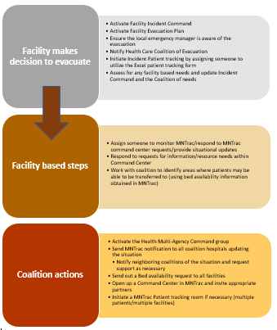
Evacuation

Slide 10
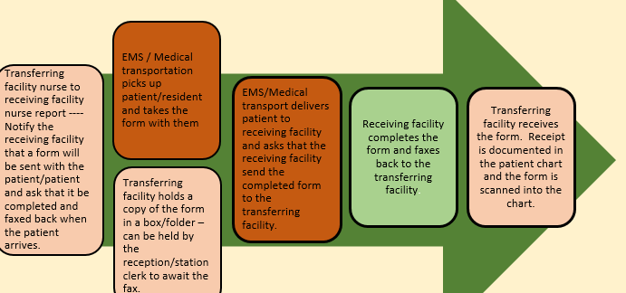
For LTC, Home Health, Hospice

Slide 11
Patient Tracking – Revised HICS 254

Slide 12
Mass Casualty Patient Tracking

Slide 13
Mass Casualty Patient Tracking
Upon notification from EMS/Dispatch of a Mass Casualty Event – facilities will:
Initiate the Patient Tracking Excel spreadsheet (HICS 254 Excel form)
Assess the need for regional assistance/notify region if necessary
Regional support includes:
Activate the Health MAC
Create an Alert in MNTrac
Open a Command Center
Activate a Patient tracking event in MNTrac and invite all partners
Assess resource needs and coordinate resource requests

Slide 14
Information Sharing
Plan outlines what information can be shared and with whom
Impacted partners are invited to the MNTrac Patient tracking portal
Emergency Management
Public Health
Health care partners
State
Notes:
Outlines the roles of health care and its’ partners in types of information that can be shared
Includes invitations to partners to MNTrac Patient tracking (Emergency Management, Local Public Health)

Slide 15
Patient tracking information flow

Slide 16
Thinking outside the box……
This plan can be used to support Family Reunification
Shelters
Alternate Care Sites

Slide 17
Questions!
Shawn Stoen
shawn.stoen@centracare.com
320-760-3513

