Slide 1
Healthcare Business Continuity Planning Workshop
Minnesota
Healthcare System Preparedness Program
Continuity of Operations

Slide 2
Workshop Agenda
Introduction
Module 1 - About Business Continuity
Module 2 - Project Initiation and Governance
Module 3 - Identifying Essential Services and Applications (Data I)
Module 4 - Prioritizing Essential Services and Establishing Recovery Objectives (Data II)
Module 5 - Developing Business Continuity Strategies and Action Plans
Module 6 - Integrating Business Continuity with Emergency Planning
Module 7 - Testing and Maintaining Business Continuity Plans
Wrap-Up

Slide 3
Overview

Slide 4
Introductions
Ed Deveau
Angela Devlen
Tom Gaitley

Slide 5
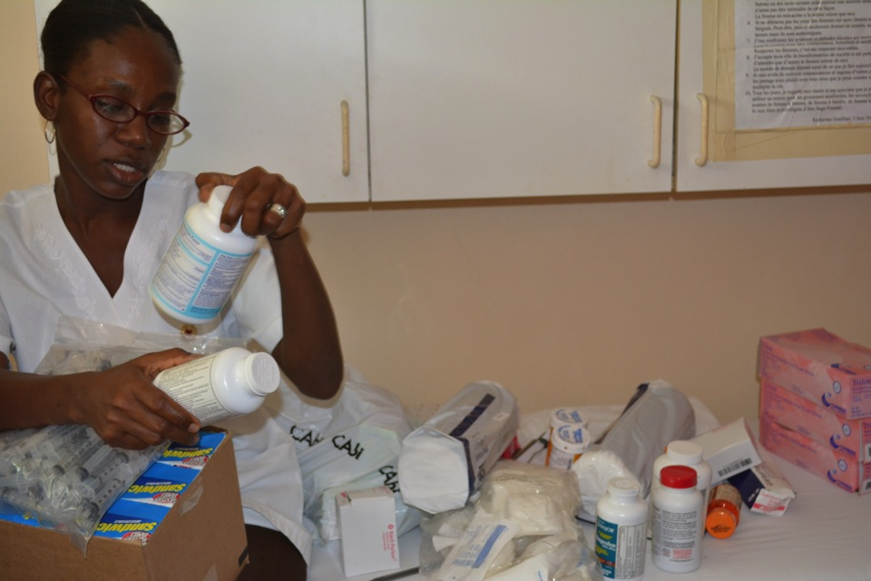
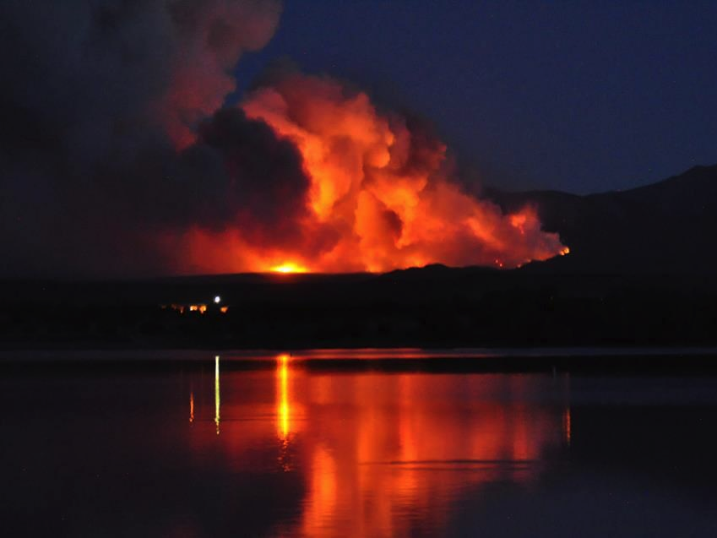
Our work in the field informs the way we advise our clients and design our programs.

Slide 6
Why are we here?
To begin a multi-year process to develop the business continuity action plans and strategies needed to maintain effective levels of patient care and essential services.

Slide 7
What’s driving this?
Changing regulatory landscape and associated funding conditions require that healthcare organizations develop and maintain higher levels of operational resiliency.

Slide 8
ISO22301 Business Continuity Requirements
ASPR Federal Guidance for COOP/BCP
Compliance deadline: HIPAA Security Rule
Joint Commission 96 Hour
Planning
Joint Commission New Leadership Standards
2005 2006 2007 2008 2009 2010 2011 2012 2013
Sarbanes Oxley Act of 2002
NFPA 1600
Standard on Disaster/Emergency Management and Business Continuity Programs
HITECH and Meaningful Use
CMS Proposed Rule

Slide 9
Photo: Jennifer Hohn

Slide 10
Lessons learned from recent events reinforce the need for more extensive Business Continuity Planning (BCP) / Continuity of Operations Planning (COOP)

Slide 11
What do we need?
Executive buy-in and support
Organizational awareness and participation
Project planning tools to define milestones, timelines and the resources needed
Simple, clearly defined plan development processes
Simple, effective data gathering and documentation tools and templates

Slide 12
How are we going to do this?
A vetted, healthcare-centric plan development process
Plan development process training and exercises
Online plan development knowledge base, tools and templates
A little bit at a time
Follow-up support from MN DH and coalition partners

Slide 13
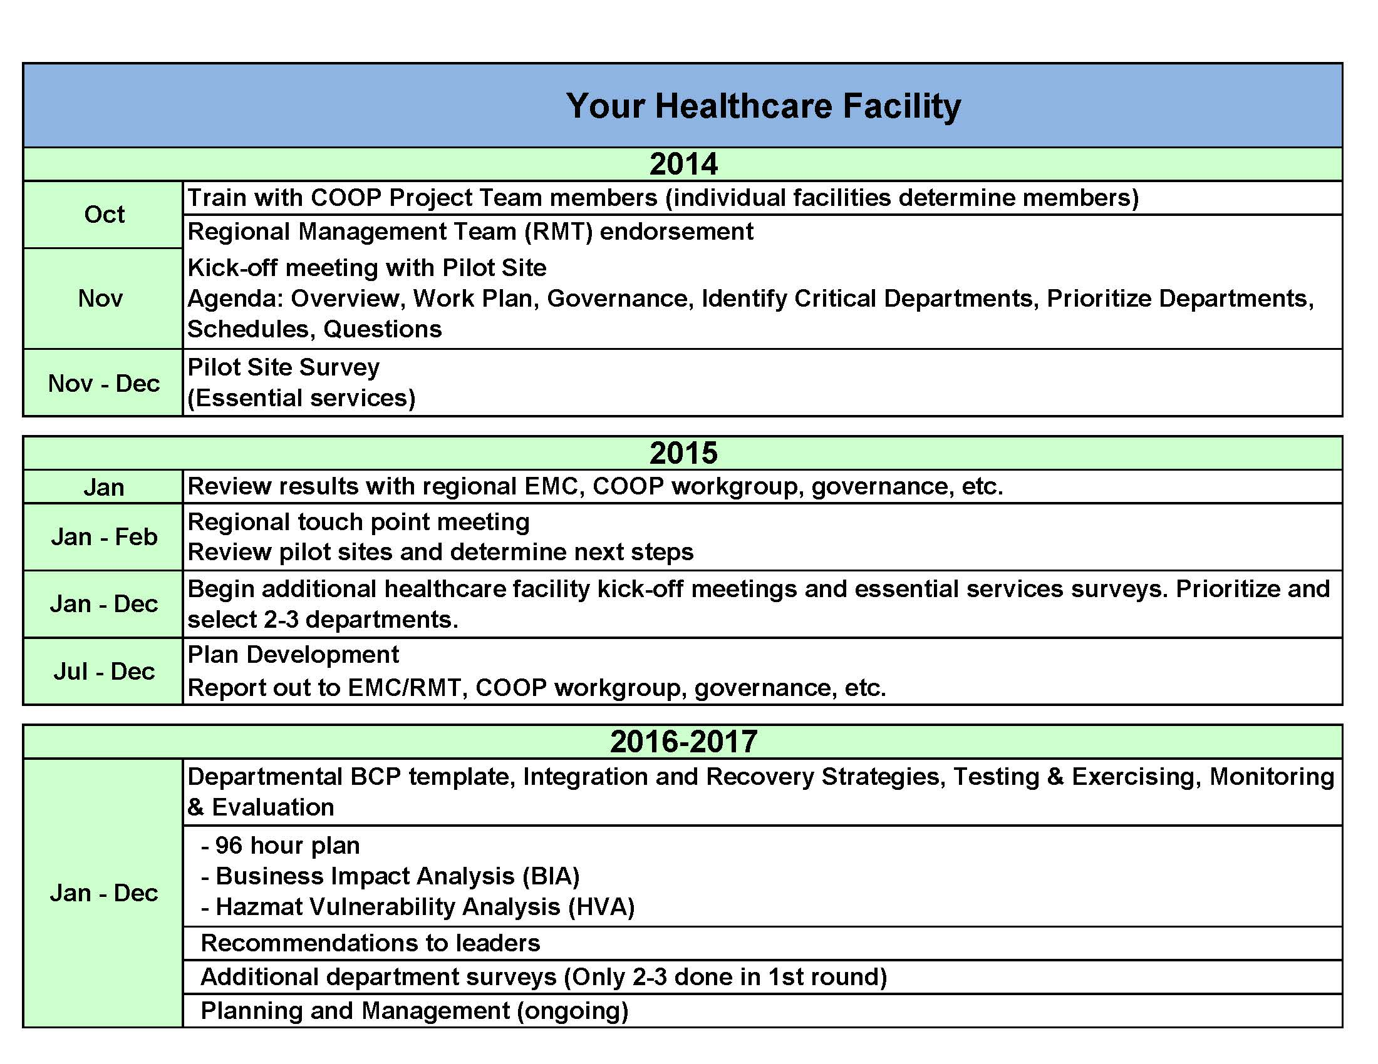
Sample project map and timeline

Slide 14
Challenges
Trained personnel needed to develop plans
Executive buy-in and support
Existing levels of organizational awareness and participation
All healthcare facilities are not alike
Small healthcare facilities have limited time and resources

Slide 15
Exercise - 1
Continuity planning challenges
What are the business continuity planning challenges your organization faces?
What will you need to address those challenges?

Slide 16
About Business Continuity
Module 1
Minnesota Healthcare System
Business Continuity Planning Workshop
www.wakefieldbrunswick.com
16

Slide 17
At the end of Module 1 you will know …
How Business Continuity integrates with the other Emergency Management components in your facility
The Business Continuity Plan development process
lll

Slide 18
What is a Business Continuity Plan?
Is it an IT disaster recovery plan?
Is it an emergency operations plan?
Is it HICS?
www.wakefieldbrunswick.com
18

Slide 19
What is a Business Continuity Plan?
The Business Continuity Plan provides information about governance and operational recovery that complements and supports the healthcare facility’s overall Emergency Operations Plan
Note: Business Continuity Planning (BCP) is often also called Healthcare Continuity, Clinical & Business Continuity or Continuity of Operations Planning (COOP).
For our purposes, all are considered synonymous with BCP.
www.wakefieldbrunswick.com
19

Slide 20
An integrated business continuity plan...
Establishes the priority and sequencing of services required to maintain essential operations (supply chain, payroll, research) and services delivery
Identifies risks and measures the impact to operations during interruption events and disasters
Provides information needed to develop effective operational recovery strategies
Builds financial resilience, mitigates economic impact of interruptions, controls recovery costs and protects market share
Improves patient safety, efficiency, availability of critical supplies and protects assets
Exceeds compliance with the increasing cross-section of emergency management and business continuity standards
Aligns with strategic priorities provides a holistic approach to organizational resilience
Protects technology investments and organizational assets

Slide 22
Exercise - 2
Operations disruption scenarios
List 5 scenarios describing a disruption to operations (a service area or department)
Can be a past event or likely scenario.
There are no injuries, fatalities or mass casualties.
“Mutual Aid” from other/outside organizations is not needed.
Scenario involves event affecting only the one location (i.e. not a community-wide or regional incident or event).

Slide 23
Business Continuity Planning Process
Planning and Initiation
Questions / Interviews
Strategies
Planning
Management
An outcome driven process that is scalable

Slide 24
Business Continuity Planning Process
Planning and Initiation
Questions / Interviews
Strategies
Planning
Management
Governance
Identify executive sponsor
Establish program framework
Form steering committee
Project Initiation
Timelines
Expectations
Deliverables

Slide 25
Business Continuity Planning Process
Planning and initiation
Questions / Interviews
Impacts and Priorities
Actions and Strategies
Plan Management
Conduct interviews
Identify mission critical functions and services
Identify enabling systems / applications
Identify critical supporting resources required
Identify high level recovery actions

Slide 26
Business Continuity Planning Process
Planning and Initiation
Questions / Interviews
Strategies
Planning
Management
Develop continuity and recovery strategies
For each action (i.e. imperative) ask: “What do I need to get this done?”

Slide 27
Business Continuity Planning Process
Questions / Interviews
Planning
Planning and Initiation
Strategies
Management
Integrate with emergency operations planning
Assume both need and no-need to relocate
Use imperatives only, begin each sentence with a verb

Slide 28
Business Continuity Planning Process
Planning and Initiation
Questions / Interviews
Strategies
Planning
Management
Ongoing program maintenance and tracking
Establish metrics
Identify opportunities for improvement
Report findings and results to steering committee

Slide 29
Module 1 Resources
Business Continuity Action Plan
PDF of Module Presentation
EM BCP Framework
lll

Slide 30
Module 1 Summary
You should now know:
How business continuity integrates with the other EM components in your facility
The business continuity plan development process
lll

Slide 31
Project Initiation and Governance
Module 2
Minnesota Healthcare System
Business Continuity Planning Workshop
www.wakefieldbrunswick.com
31

Slide 32
At the end of Module 2 you will know …
How to define your goals
How to complete a task plan
Resources requirements that need to be identified
Who may be your executive sponsor
How to form your steering committee
How to create a strategy for leadership engagement and program governance
lll

Slide 33
Project Initiation
Defining goals and identifying what is needed to achieve them

Slide 34
Scoping the effort
Who owns the responsibility for the developing and managing the plan?
Is there Executive buy-in and support?
What is the level of continuity planning and awareness within the operational departments at your facility?
How many operational departments do you ultimately need to develop plans for?

Slide 35
Planning the effort
Establish plan development goals for each of the next three years
Schedule and conduct executive briefing to get buy-in/support to proceed
Identify operational units and unit representatives to be assigned to support plan development efforts

Slide 36
Exercise - 3
Setting your goals
Answer the scoping questions as best you can for your facility
Create 4 – 6 plan development goals that cover the short, mid-, and long-range (1, 3 and 5+ years)
Consider what people, resources and actions are needed to help achieve your goals

Slide 37
Governance
Establishing executive guidance and support

Slide 38
Identify your executive sponsor

Slide 39
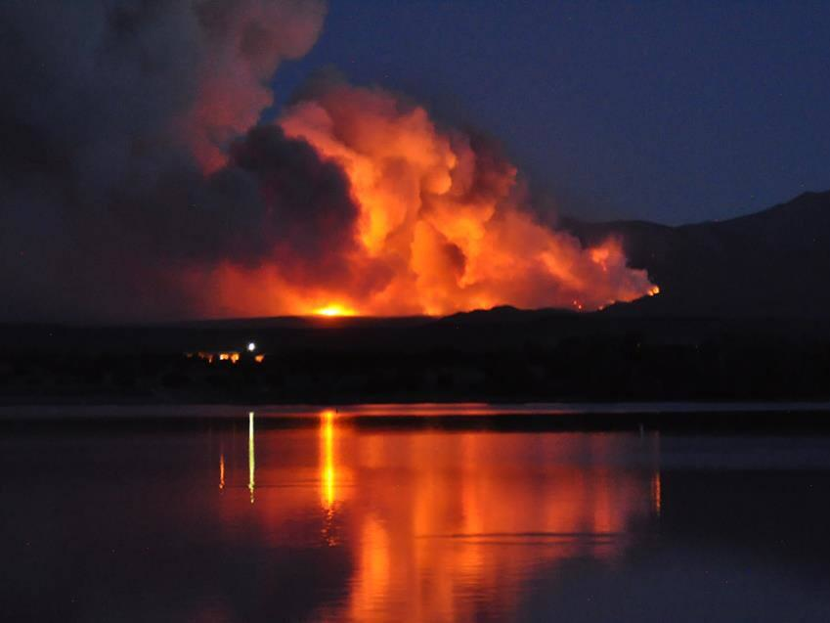
Photo: Jennifer Hohn
Notes:
Case example: Spanish Peaks. Useful because was pilot for BC planning in CO Hospitals. Used it as driver for program.
Engaged leaders, identified who would facilitate process. Was acceptable to CEO for activities. Process allowed for policy decisions to be made during the process. Ran interviews with all ops heads all in one week as a result of the way it was set up. Have your plan as to what your going to be asking people for
Program Policy is for both EM and BCP

Slide 40
Establish policy / identify sponsor
Refer to the business continuity program policy template
Tailor the policy template to your organization
Coordinate with your supervisor to identify a leader to serve as your executive sponsor
Work with your executive sponsor and supervisor to form your committees

Slide 41
Form a Steering Committee

Slide 42
A committee responsible for program governance that meets at least quarterly to review progress reports and make decisions.
Members include executive sponsor (e.g. COO), and key leaders (e.g. CNO, VP Facilities, CMO, VP Human Resources, Emergency Manager and CIO).
Steering Committee
Chairperson
Members
Continuity Committee
Chairperson
Members
A committee responsible for executing projects/activities led by the Continuity Coordinator/Chairperson.
Members include key operational leaders (e.g. supply chain, support services, finance, risk/compliance, emergency management, IT disaster recovery, security, emergency dept., human resources, nursing)
Note: One person may fill many of these “roles” in a smaller organization

Slide 43
Exercise Setup - 4
Identify participant roles:
The participant with a pink sticker on their test will be the coalition coordinator and lead the exercise.
The participant with the orange sticker will be the hospital coordinator.
The participant with the green sticker will take notes on the governance exercise document.
The coalition coordinator and the hospital coordinator will work together to address the following three questions on the governance exercise document.
3. The note taker will document answers on the governance exercise document.
43

Slide 44
Exercise - 4
Establishing governance structure
What are the Business Continuity strategic priorities of your organization?
Who is your executive sponsor? If you do not have a sponsor identified, list one or more leaders you will approach to serve in this role.
Who is on your business continuity steering committee? If you do not have one in place, describe how you will establish a committee and those you will approach to serve on this committee.

Slide 45
Leadership Engagement and Program Governance

Slide 46
“
Leaders have to worry about BCP. First, as broadly as possible, then focus on the key areas, then knit it into other work at the Institution … particularly people who deal with safety, operations and security. Integrating BCP with the business of the institution, as opposed to a function off to the side, not only provides a risk mitigation strategy but a business effectiveness strategy.
~James Conway, past COO Dana-Farber Cancer Institute, Senior Fellow, Institute for Healthcare Improvement
”

Slide 47
Educate and engage leadership
Tailor the materials to your organization
Send executive letter with SBAR
Conduct an executive briefing/presentation and reinforce key principles in SBAR
Present the policy, organization chart and leadership briefing to your steering committee
Gain approval from steering committee on policy and organizational chart

Slide 48
Module 2 Resources
Business Continuity Action Plan
PDF of Module Presentation
CEO Letter Template
EM BCP Policy Template
EM BCP SBAR Template
Governance Committee PDF
Task/Resource Planning Template
Template List of Core Services and Operations in Healthcare Facilities
Governance Exercise
Governance BCP Structure PowerPoint Slide
Steps for Leadership and Physician Engagement
lll

Slide 49
Module 2 Summary
You should now know how to:
Define your business continuity planning goals
Complete a task plan
Identify resources requirements
Identify your executive sponsor
Form a steering committee
Create a strategy for leadership engagement and program governance
lll

Slide 50
Identifying Essential Services and Applications (Data I)
Module 3
Minnesota Healthcare System
Business Continuity Planning Workshop
www.wakefieldbrunswick.com
50

Slide 51
At the end of Module 3 you will know …
How to identify and engage key operational unit representatives
Different types of interview questions and their uses
How to conduct an interview
How to document information obtained in the interview
lll

Slide 52
Purpose
Define the essential functions, services
Determine the realistic impact of unplanned disruptions
Identify applications and systems required
Identify organizational and IT systems interdependencies
Identify high level recovery actions and strategies
www.wakefieldbrunswick.com
52

Slide 53
Develop interview questions
Start Simple – no more than 10 questions
Understand the desired outcomes
Essential functions and applications
Impact of service interruptions
Recovery actions
Vital records
Vital equipment

Slide 54
Exercise – Developing Questionnaire
Exercise – 5a
Developing and conducting interviews - I
Refer to “BCP Demo - Questionnaire” in your exercise workbook
Review example questions
Set objectives for your BIA
Develop your questions
Questions that result in measurable data
Avoid highly subjective questions
Give specific examples for them to consider
www.wakefieldbrunswick.com
54

Slide 55
Setting up interviews
Identify operational departments identified in plan development goals
Coordinate with departmental management to identify representative to participate in the interview
Communicate with representative to provide information about the process and schedule interview
Send out introductory e-mail at least 3-4 weeks prior to interview and a follow-up e-mail one week prior
Schedule 1-1/2 Hour for Interview with Operations representatives, 2 hours with IT representatives

Slide 56
Conducting the interview
Hold the interviews in a neutral site (i.e. conference room) so they come to you – where distractions are limited
Schedule the interviews back-to-back (with 15 minute break for notes review)
Limit the interviews to one functional area and no more than around 5- 6 people beside yourself – err on the side of less people
You take all of the notes!!! Interviewees will love you for it and you will end up with better control of the project deliverables
Conclude by reflecting back to interviewees any actions, to-do items, or issues you have identified

Slide 57
Techniques for Successful Interviews
Technique | Description | Example
Direct Question | Seeks specific information. | How would you rate the risk to patient safety, when your are unable to enter physician orders?
What If/ Just Suppose | Helps people move beyond their limited, well-defined, present circumstances to consider creative alternatives. | What if your primary space of operations was unavailable - what would you do first to resume your department’s essential functions?
Use prompts and probes | The first answer you get is rarely all of it. Learn to follow-up on a question, and to prompt more from people on the meaty issues. | - Really? Can you be more specific about that? - That’s good, but it would help if you could give me a few examples. - Oh? And then what happened?
Summarize | Periodically, recap the key points the interviewee has raised. This helps ensure mutual understanding. It also serves as a prompt to elicit more information | So if I’ve understood you correctly, your primary concern would be contacting vendors needed to establish mobile operations. Is this correct?

Slide 58
Types of Interviews
Structured
Unstructured

Slide 59
Exercise – 5b
Developing and conducting interviews - II
Assign roles:
Department representative; Interviewer; Note taker
Rotate roles: Each person takes a different role at least once
Select a department from the scenarios created in Exercise-2.
Conduct interview using a combination of open-ended, “what if/ just suppose”, and probing questions to identify:
The most important activities that they do? (tasks, functions, etc.)
Who do they rely upon to do it and who relies upon them (interdependencies)?
What equipment, systems, applications and resources they use?
www.wakefieldbrunswick.com
59

Slide 60
Documenting information obtained
Use template to simplify consistent data capture
Complete documentation as soon as possible after interview while it’s fresh in your mind
Send copy of completed template to interviewee to review and validate

Slide 61
Module 3 Resources
Business Continuity Action Plan
PDF of Module Presentation
Sample email to department head requesting function representative
Sample email to function representative assigned to be interviewed
BCP Demo - Questionnaire
10 tips for interviews
lll

Slide 62
Module 3 Summary
You should now know how to:
Identify and engage key operational units representatives
Develop interview questions
Conduct an interview
Document information obtained in the interview
lll

Slide 63
Prioritizing Essential Services and Establishing Recovery Objectives (Data II)
Module 4
Minnesota Healthcare System
Business Continuity Planning Workshop
www.wakefieldbrunswick.com
63

Slide 64
At the end of Module 4 you will know…
How to prioritize essential functions
How to establish recovery objectives for your IT applications
Key elements to include in your report
lll

Slide 65
Purpose
Document business recovery priorities and objectives
Inform organizational efforts to establish business recovery strategies that meet business recovery objectives
Inform IT efforts to establish recovery strategies that meet business recovery objectives

Slide 66
Develop impact analysis data
Validate/modify criticality definitions and scores
Validate/modify impact categories to be used
Validate/modify weights to be used for each category
Input department’s functions and services identified during 1st interview
For each function/service input the IT systems/services required
Conduct interviews with operations representative to identify/record impact ratings

Slide 67
Exercise - 6
Establish operational impacts
Use the Essential Functions table in your workbook
List three functions/services for your department
Review impact categories and enter any additional categories needed
For each function/service, assign ratings in each impact category using the scoring chart provided

Slide 68
Exercise - 7
Establish IT systems impacts
Use the IT Systems Impact table in your workbook
For each function/service, listed in the worksheet from Exercise-6, enter the names of the IT systems required
Enter any additional impact categories that you may have identified in Exercise-6
For each IT system, assign ratings in each impact category using the scoring chart provided

Slide 69
Establishing weights for impact ratings
During your analysis, scores can be also be “weighted”, to characterize the magnitude of the impact as well.
The survey recipient/interviewee chooses from a range of scores of 1-5 for consistency and simplicity.
1 = 1
2 = 3
3 = 5
4 = 7
5 = 14
Consistent
Repeatable
Informed Decision
Essential Function or Service | Patient Safety Impact | Operational Impact | Family Experience Impact
Provide patient care | 5 | 5 | 5
Acquisition and requisition of essential supplies | 3 | 4 | 2
Nursing administration | 1 | 3 | 1
14+14+14 = 42

Slide 70
Establishing recovery objectives

Slide 71
Definitions
Recovery Time Objective (RTO) defines the maximum duration of a service or application outage before significant operational, patient care or family experience impacts occur.
Recovery Point Objective (RPO) is the point in time of the last good backup of data offsite at time of disaster and identifies the amount of acceptable data loss.

Slide 72
RTO/RPO Matrix
RTO / RPO | < 2 hours | < 8 hours | <48 hours | >48 hours
RPO <1 hour: Little to No Data Loss Tolerated/Unable to recreate data | Tier 1: High avail/Synch | Tier 2: High avail/Asynch
RPO 24: One day of data loss allowable or can be recreated/ reentered from back log or tape back up |  |  | Tier 3: Hot Site | Tier 4: Drop ship/Cold Site

Slide 73
Your BIA report

Slide 74
Report on findings
Create 1-page executive summary of the initial impact findings and issues
Findings and recommendations
Provide a statement of the organizational goals and objectives
Summarize the impacts to those goals and objectives as a result of a disruption
Document the tiers of functions and applications
Provide a summary of the resource requirements & recommended strategies to recover and resume operations according to tiers
Identify any gaps in recovery capabilities and requirements
HINT: Be concise. Use graphs, data and illustrations.

Slide 75
Using the BIA Data for your BCP
Tier 1
Definition: | Critical Services for Core Hospital Operations and Patient Safety
Recovery Point Objective (RPO): | Within 15 minutes from original point of failure
Recovery Time Objective (RTO): | Less than 2 hours after Interruption
Capacity Assumptions: | Limited capacity until event – On demand scale up within RTO
Tier 2
Definition: | Important Services – May be dependent on a Tier 1 service or application
Recovery Point Objective (RPO): | Within 15 minutes from original point of failure
Recovery Time Objective (RTO): | Within 72 hours after interruption
Capacity Assumptions: | Limited capacity until event – Scale up within 24 to 72 hours after declaration
Tier 3
Definition: | “Other” Services – little or no impact to Tier 1/2 restorations and recovered after
Recovery Point Objective (RPO): | Within 15 minutes from original point of failure
Recovery Time Objective (RTO): | Within 3 – 7 days after interruption
Capacity Assumptions: | Limited capacity until event – Scale up within 7 – 14 days after declaration
Tier 4
Definition: | Non-time Sensitive Services – can defer recover beyond 14 days
Recovery Point Objective (RPO): | Within 15 minutes from original point of failure
Recovery Time Objective (RTO): | Within 30 days interruption or recover as needed
Capacity Assumptions: | Limited capacity until primary facility restored

Slide 76
Number of Essential Functions by Tier
Data/Illustrations Examples
# Departments (+% response rate), # functions and/or applications by Tier, data illustrating impact ratings

Slide 77
Module 4 Resources
Business Continuity Action Plan
PDF of Module Presentation
Questionnaire Scores Analytics Demo
lll

Slide 78
Module 4 Summary
You should now know:
How to prioritize essential functions
How to establish recovery time objectives for your IT applications
What key elements to include in your report
lll

Slide 79
Developing Business Continuity Strategies and Action Plans
Module 5
Minnesota Healthcare System
Business Continuity Planning Workshop
www.wakefieldbrunswick.com
79

Slide 80
At the end of Module 5 you will know …
lll
How to identify and evaluate recovery strategies
A simple process to develop recovery action plans

Slide 81
Identifying and Evaluating Strategies

Slide 82
Purpose
Scalability: Develop strategies and tactics that allow for events that will scale from operational interruptions through catastrophic events
Decision Support: Improve access to meaningful information and guidance to allow for effective response and recovery

Slide 83
The guiding principles that support our mission are the same ones that govern our approach to Emergency Management and Business Continuity.
Principle 1: Healthcare That Is Safe
During disasters, our communities look to us for the care they need more than ever. Our role is to continue to provide healthcare that is safe at all times, including at times of crisis.
Principle 2: Healthcare That Works
Through seeking opportunities for strengthening existing operating procedures that yield both daily operational efficiencies and improved response if procedures are to be carried out in a crisis situation, we succeed in carrying out our mission to provide healthcare that works for every patient, every time.
Principle 3: Healthcare That Leaves No One Behind
Research has shown the disparities that exist regarding the access to care for our most vulnerable populations. This problem is significantly exacerbated during disasters. People who may have response access barriers such as frail elders, children, people with disabilities of any kind, communication barriers due to language and cultural/ethnic needs and any others who may be vulnerable under any particular disaster scenario are part of our all-inclusive approach to emergency management.
“Our role is to continue to provide healthcare that is safe at all times, including at times of crisis.”
“Through seeking opportunities for strengthening existing operating procedures that yield both daily operational efficiencies and improved response..”

Slide 84
“
Plan identifies organization's capabilities & establishes how it will continue to operate, when organization cannot be supported by the local community for at least 96 hours, if it elects to remain open & provide services post disaster
~Joint Commission
”

Slide 85
Continuity of Operations/Business Continuity Planning
Effective 96 Hour Assessment
WATER
FOOD
SHELTER
SANITATION
SAFETY/SECURITY
TRANSPORTATION
COMMUNICATION
CORE CRITERIA
Lesson Learned: All essential elements of emergency response and healthcare continuity are sustained by a system of critical non-medical elements that provide essential infrastructure.

Slide 86
Continuity Strategies
Normal - Generator Fuel
Alternate Site
Emergency –shut down floors, cancel elective surgeries, close non-essential buildings, etc.
Normal – Clinical Supplies
Emergency – curtail some services, discharge some patients
Normal – Water (Sanitary)
Emergency – sponge baths, …….
0 hrs
24 hrs
48 hrs
72 hrs
96 hrs

Slide 87
Evaluate strategies
Staff Rotation: place focus on after the event
Procedures for the rapid recruitment and training
Policies for flexible worksite and flexible work hours
Supply Chain: Understand what is on-hand for critical supplies and plan for interruption of deliveries
Support Services: Non perishable food that can be prepared in a powerless kitchen
Utilities: Contingencies for continuation or rapid resumption of essential services: e.g. Water that can be treated (Wells, generators for the ability to pump water)
People
Process
Place

Slide 88
Evaluate strategies
Evaluate strategies for continuity of operations in the event the primary location is unavailable
Alternate Location Considerations
Align plans for relocation and continuity of essential clinical services with surge/expansion plans
Include Business, Research and Ambulatory Services
Mobile Services Considerations
Tent operations, portable surgical units, kitchens, labs, diagnostic imaging units, pharmacy units, etc.
Supplies, security, water, medical air and technology are essential

Slide 89
Select and approve strategies
Solicit cost estimates for selected alternate site, mobile and disaster recovery strategies
Present recommended strategies and pricing options to governance group or steering committee for approval

Slide 90
Exercise - 8
Identifying recovery strategies
Using the departments / functions identified in Exercises 6 & 7, identify high-level strategies you would implement to recover essential functions/services and maintain delivery of care/services if:
The primary place of operation is completely and/or partially unavailable
Critical supplies and equipment were lost/damaged (or the supply chain interrupted)
The IT systems were unavailable
Example: Radiology Department
Agree upon / implement accepted substitute imaging (X-ray vs. MRI)
Redirect to other “system” location
Obtain mobile solution

Slide 91
Developing Recovery Actions

Slide 92
Follow the project goals and use the data that has been gathered
Follow goals and objectives established in project initiation and governance phase
Develop actions for departments and services that have participated in the Data I and Data II interviews
Use information gathered in the interviews to inform actions and strategies

Slide 93
Develop recovery actions
Begin each sentence with a verb
Document actions for
assessing impact and determining length of interruption
deciding when to initiate department closing and/or relocation actions
communicating with all affected internal and external constituencies
relocating and restarting departmental functions and services
validating recovered functions, services and systems
returning employees to normal workspace and resuming normal operations

Slide 94
Exercise - 9
Developing recovery actions
Identify recovery actions you would take to manage and implement recovery strategies for department/functions you used in Exercise - 6
Assume worst-case (i.e. scenario-less and multi-scenario approach)
Assume both - that there is a need to relocate and that there is no-need to relocate
Example: Radiology Department
Contact imaging equipment vendors/technicians to initiate assessment and repairs.
Notify XYZ Radiology Department of need and begin to schedule priority tests.
Arrange for patient transportation to alternate imaging location (e.g. XYZ Dept).
Work with Facilities Services to prepare area for inbound mobile equipment.

Slide 95
Create departmental plan
Establish criteria/template for Departmental Plans
Department Status Forms/Summary
Criteria and steps for closing and relocating a department
Downtime procedures/template for an extended IT outage
Enter data from the BIA Questionnaire into Departmental BCP Template
Establish agreements with vendors and suppliers who will support recovery and resumption activities (e.g., debris removal, vital record recovery, building contractors, technical equipment vendors, recovery site(s) owners/vendors)

Slide 96
Exercise - 10
Creating departmental plans
Refer to the “BCP Demo 2 Template” in your workbook
Use or copy information from the department’s Questionnaire worksheet into the BCP worksheet
Essential Functions
Essential Applications
Vital equipment and supplies
Vital records

Slide 97
Module 5 Resources
Business Continuity Action Plan
PDF of Module Presentation
BCP Demo 2
lll

Slide 98
Module 5 Summary
You should now know how to:
Identify and evaluate strategies
Develop recovery actions
lll

Slide 99
Integrating Business Continuity with Emergency Planning
Module 6
Minnesota Healthcare System
Business Continuity Planning Workshop
www.wakefieldbrunswick.com
99

Slide 100
At the end of Module 6 you will know …
lll
How to establish the framework for your integrated program

Slide 101
Create overarching BCP
Document delegation of authority and orders of succession
Align initiation and termination procedures associated with business continuity with existing procedures in the EOP and which incorporates the Hospital Incident Command System (HICS)

Slide 102
Integrated Resiliency Model
There is precedent for a more holistic approach that goes beyond traditional emergency planning or compliance.
An integrated program helps achieve true organizational resilience.
Governance
EM
BCP
DR
Ops
EM
BCP
DR
Ops
EM
BCP
DR
Ops
Enhance operations and capabilities.
Strong Core
Ability to change and adapt.
Proactive Response
Reshape environment as needed.
Resilience achieved
Notes:
Ed D Note:speak to angela about Changing DR to IT, change Ops to EOP

Slide 103
Lesson Learned
Ensure strategies and procedures extend to recovery and resumption of normal operations. Begin recovery strategies from onset of event to re-establish capabilities.

Slide 104
Photo: Jennifer Hohn

Slide 105
Emergency Operations
Business Continuity
Disaster Recovery
Actively managing an emergency event.
Incident command activated.
Emergency operations plan activated.
Planning for evacuation.
Planning for continuing operations – focus on ancillary departments, emergency services, and assessing alternate care facility. Planning for pre-staging, procuring, transporting, fuel and set up of supplies.
Planning for relocation of desktop computers and servers.
Photo: Jennifer Hohn

Slide 106
Exercise - 11
Creating a framework
Review the “EOP – BCP Plan Content” document in your workbook
Cross out any elements that you don’t think belong in your integrated plan
Circle elements that currently exist and you wish to preserve
Put an asterisk “*” next to items you want to add
Write in any additional elements you want to add

Slide 107
Module 6 Resources
Business Continuity Action Plan
PDF of Module Presentation
Spanish Peaks Master BCP – Public
EOP – BCP Plan Content
lll

Slide 108
Module 6 Summary
You should now know how to:
Establish a framework for integrating your business continuity plan into the Emergency Management program at your facility
lll

Slide 109
Testing and Maintaining Business Continuity Plans
Module 7
Minnesota Healthcare System
Business Continuity Planning Workshop
www.wakefieldbrunswick.com
109

Slide 110
At the end of Module 7 you will know …
How to test your plan
Key elements to successfully manage the maintenance of your plan
lll

Slide 111
Testing and Exercises

Slide 112
Testing and exercising
Conduct department specific exercises (e.g., operating department using downtime procedures, department closure/relocation/resumption of operations)
Exercise can consist of simple table top review at departmental meeting
Include scenarios with operational impacts (e.g., supply chain operations, critical infrastructure, technology)
If plan includes alternate sites, validate functionality from alternate site(s)

Slide 113
Exercise - 12
Establishing testing objectives
Referring to the list below as examples, develop three other objectives that you may include in your next drill, test or exercise.
Test Downtime Procedures: Departments demonstrate ability to carry out essential functions for 4 hours using downtime procedures for EHR outages
Test Telecommuting Strategy: Conduct a work-from-home day with all departments in administration building
Test Department BCP: Conduct a drill with one department involving relocation and resumption of essential functions as defined in the departmental BCP

Slide 114
Case Example Summary
Lessons learned from the fire incorporated into EOP and BCP
Efforts to further integrate ongoing – overarching policy
Completed interviews for all departments
Completed plan for all departments
Documented essential functions, not just departments.
Engaged leadership across the hospital and LTC during interviews to discuss opportunities for improvement and ensuring safety.
Completed Supply Chain BCP/COOP.
Used a planned event to test new plan
Photo: Jennifer Hohn

Slide 115
Monitoring and Evaluating

Slide 116
Monitoring and Evaluating
Track and monitor plan departmental reviews, updates and exercises
Maintain list of outstanding “to dos” and issues and monitor progress in resolving them
Track and monitor organizational continuity metrics (e.g. # BIAs completed, # plans completed, # exercises conducted)

Slide 117
Module 7 Resources
lll
Business Continuity Action Plan
PDF of Module Presentation

Slide 118
Module 7 Summary
You should now know:
The types of exercises that you can use to test/validate your plan
How to establish objectives for your continuity plan exercises
How to effectively maintain your plan
lll

Slide 119
Wrap Up

Slide 120
Thank You
Questions? Contact Angela at adevlen@wakefieldbrunswick.com

