Slide 1
F-M Ambulance’s HCID Transport Team
Presented by Brett Wigglesworth

Slide 2
Team Purpose
Support rapid and effective response and transport.
Minimize exposure of health care workers and the public.
Identify and isolate symptomatic patients.
Identify infection control steps for the patient and their contacts.
Share accurate information and findings to transferring hospital and staff.

Slide 3
The “E” Word!?

Slide 4
What types of patients do we respond to?
A patient with a confirmed or suspected symptomatic infection with a pathogen that meets either of the following criteria:
Pathogens that creates Class A medical waste.
Pathogens with the potential to cause a high mortality rate among otherwise healthy people which no vaccine exists and has one or both of the following characteristics:
Clinical specimens pose generalized risks to lab personnel
Known risk of airborne spread within the health care setting or has an unknown mode of transmission.

Slide 5
Possible Disease Syndromes
Hemorrhagic Fevers (e.g., EVD, Lassa Fever, Crimean-Congo Hemorrhagic Fever, etc.)
Poxvirus Diseases (e.g., smallpox, monkey pox etc.)
Febrile Neurological Illnesses (e.g., Nipah Virus, Hendra Virus, etc.)
Febrile Respiratory Illnesses (e.g., SARS, MERS etc.)

Slide 6
How would we get requested?
By the Department of Health
By an ambulance service on a scene
By an ambulance service that has been requested by a hospital for transfer of infected patient.

Slide 7
Requesting in the field.
When potential HCID patient is found:
Immediately contact the nearest HCID Ambulance Service
Do not leave the scene! Set up safe zone of 6-10 feet from patient. Communicate with the patient!
Don available PPE (gloves, N95, gowns, etc.)
Continue to assess the patient’s condition and follow your protocols
Provide routine assistance to the patient as needed
Communicate your findings to the incoming HCID Ambulance crew until they arrive.

Slide 8
Requested by a Hospital?
Inform the hospital that your service does not have the capabilities.
Obtain the direct contact name and number of the person requesting.
Contact nearest HCID Ambulance Service.
Provide them with the hospital and contact information

Slide 9
24/7 Contact Information for Minnesota Ebola/HCID Ambulance Services
Service | 24/7 Contact Number
Allina Health Emergency Medical Services | (651) 222-0555
Altru Ambulance Service: Altru Health System Emergency Dept. | (701) 780-5280
FM Ambulance Service | (701) 364-1700
Gold Cross Ambulance Service | (507) 288-2407 or (800) 237-6822
HealthEast Ambulance Service | (651) 232-1717
North Memorial Ambulance Service | (763) 581-2897
Willmar Ambulance Service: Rice Memorial Hospital | (320) 231-4212

Slide 10
What should you expect when we arrive?

Slide 11
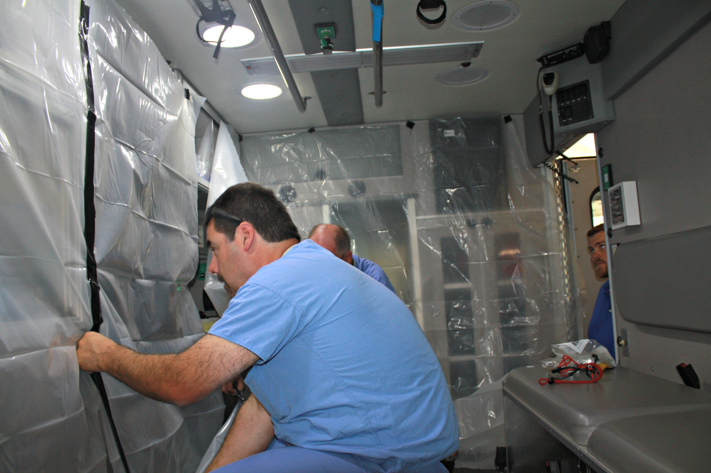
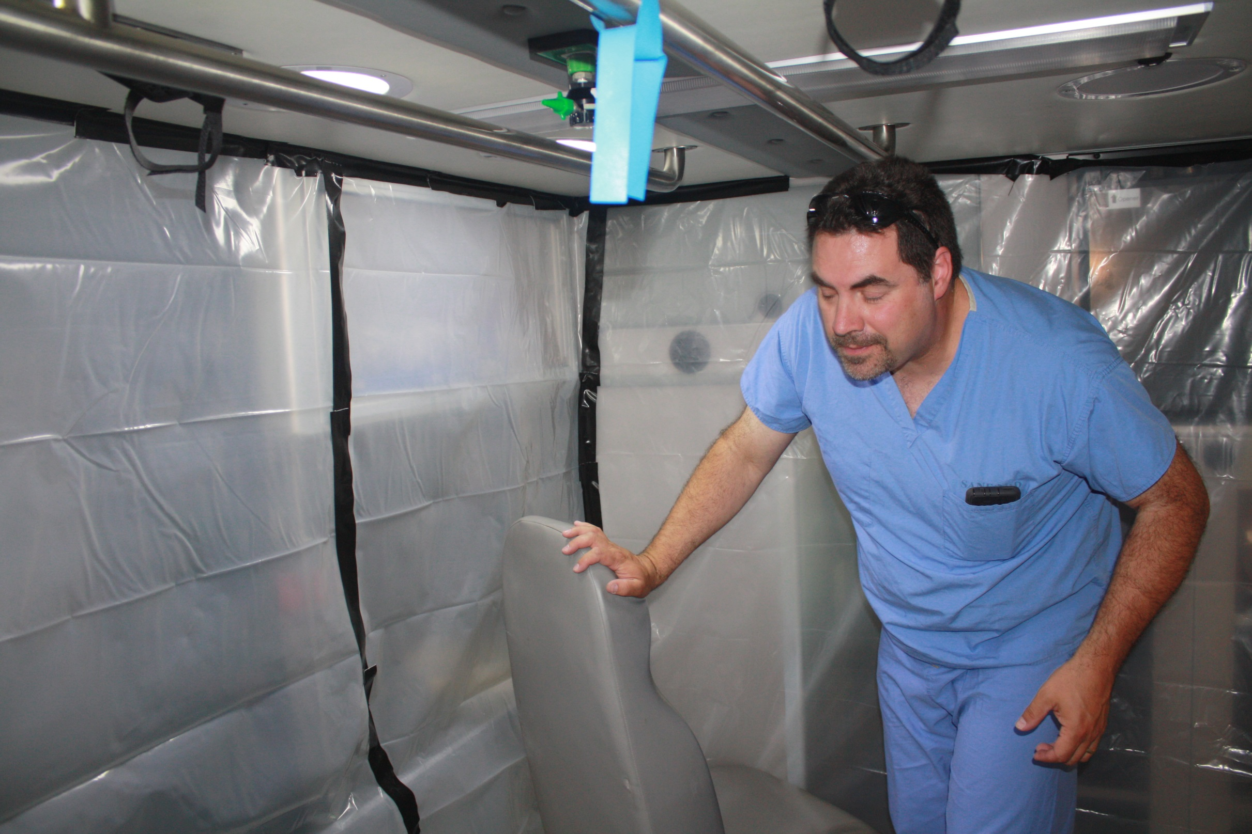
Ambulance Prep

Slide 12
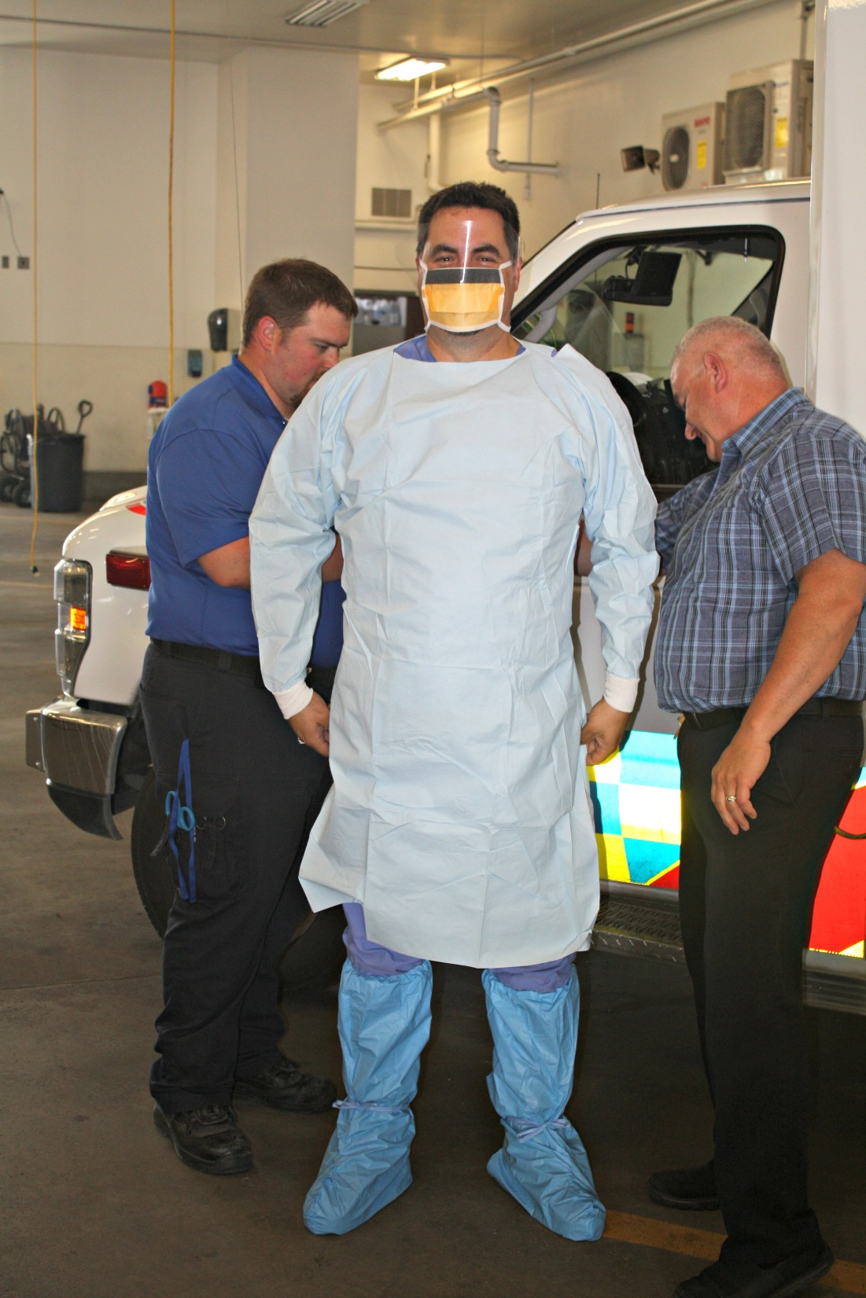
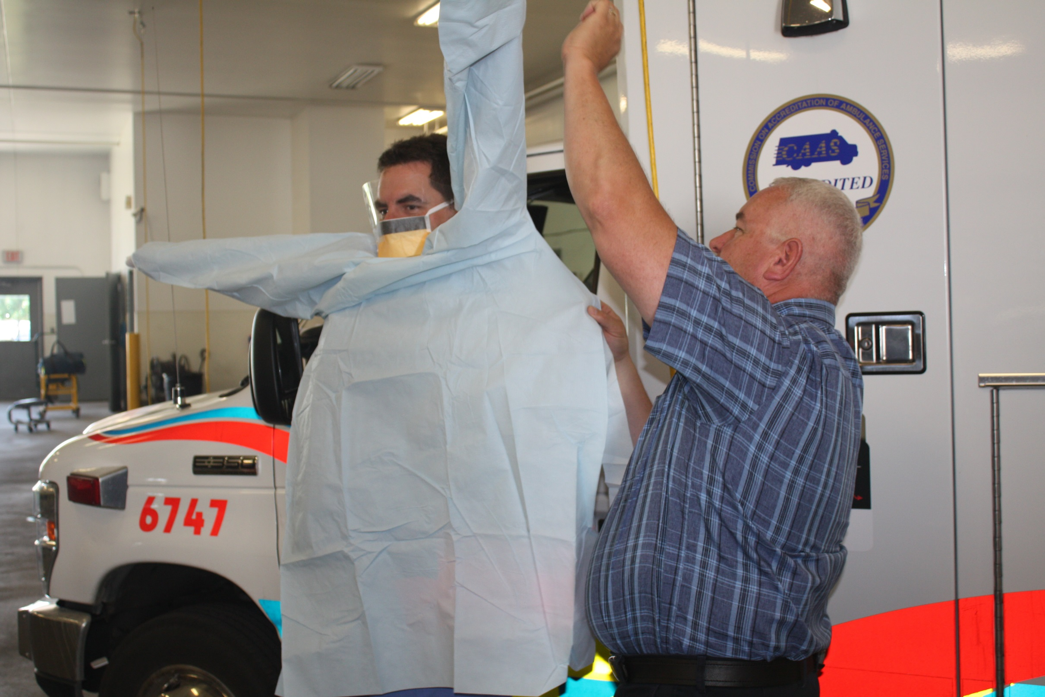
Donning PPE

Slide 13
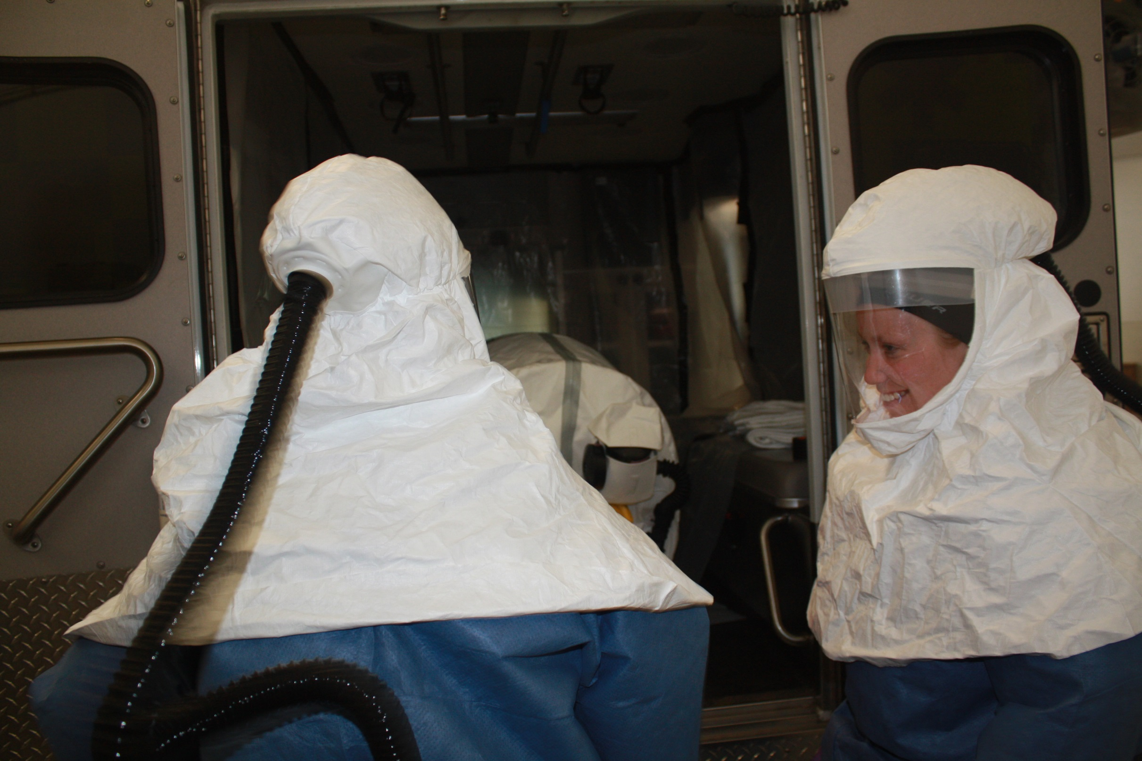
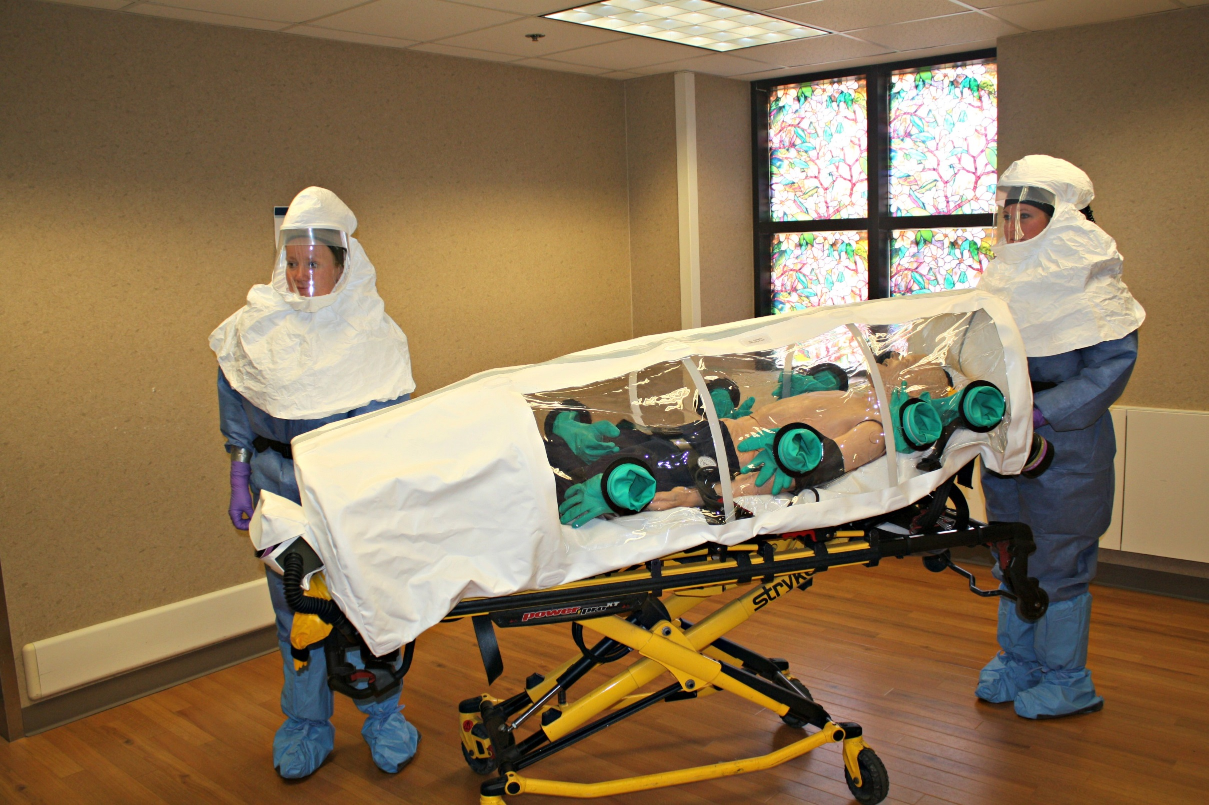
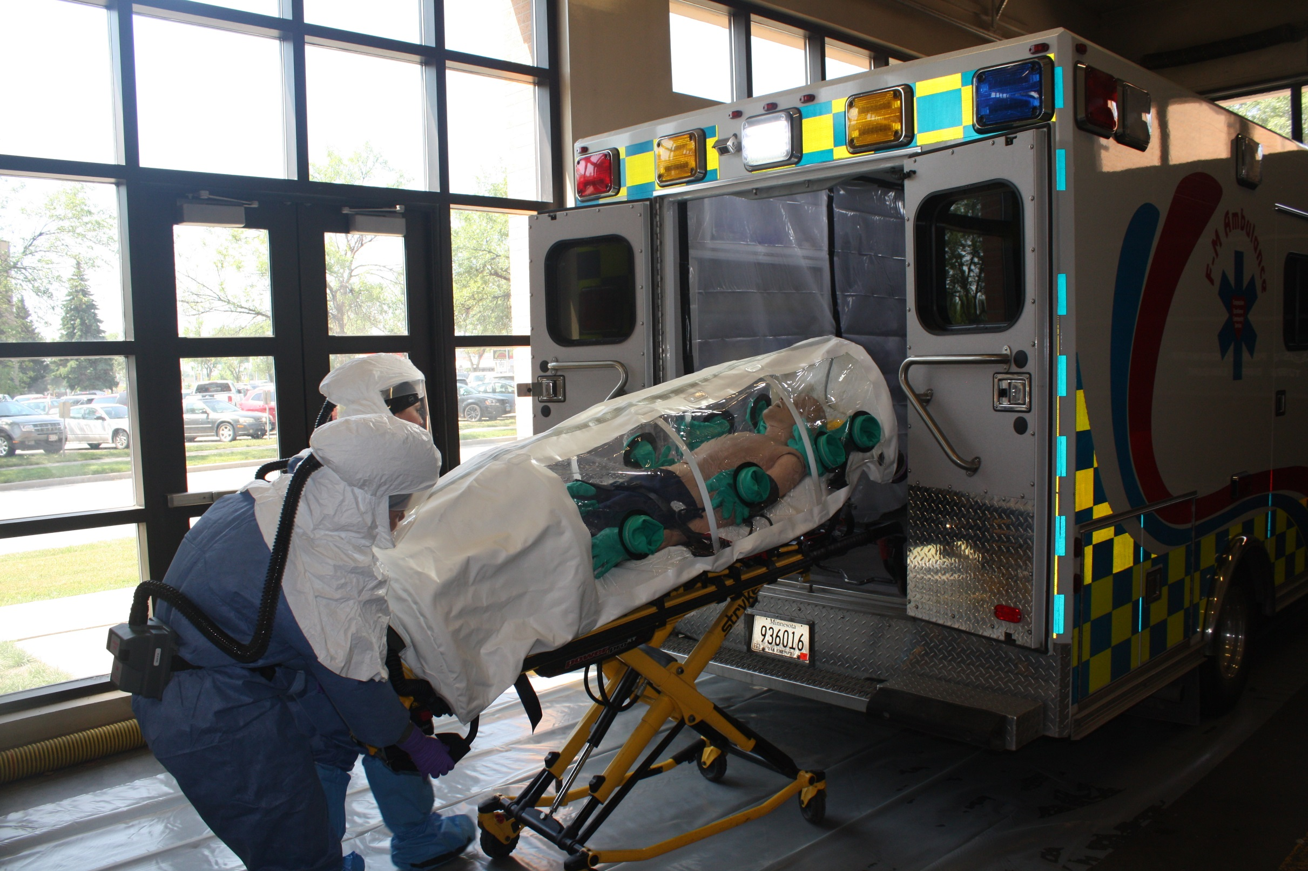
SPACE SUITS!

Slide 14
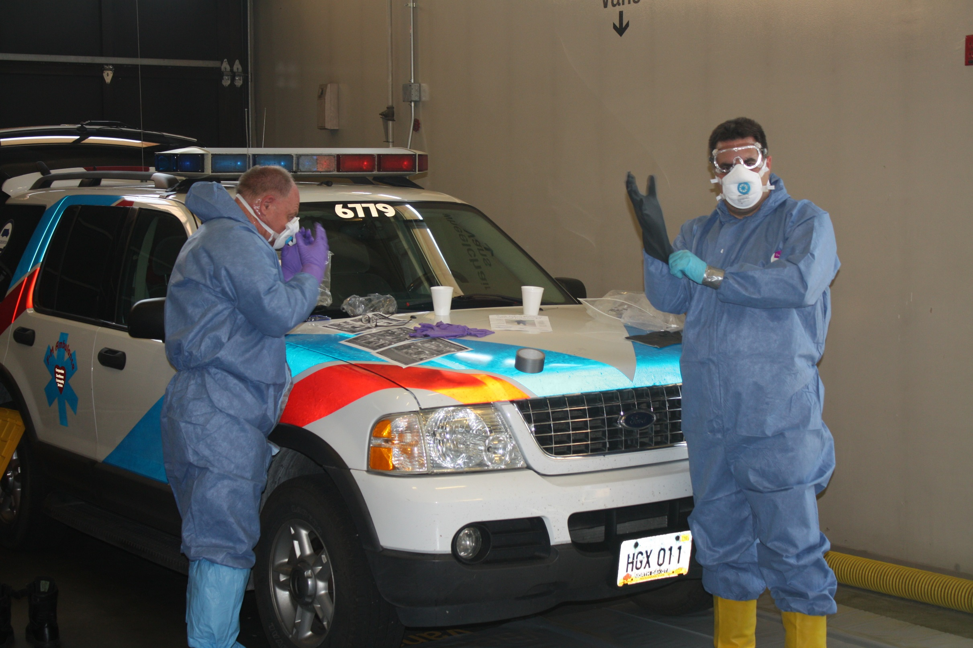
DECON

Slide 15
What are we looking for?
Most current patient info and clinical findings. Teamwork!
A place for donning PPE. (We like to get comfortable)
A clear designated pathway inside the facility/building to bring the patient to the Ambulance.
TIME!

Slide 16
Questions?

