Slide 1
BUSINESS RECOVERY TOOLKIT WEBINAR
February 16 & 25 and March 9 & 18, 2021
Notes:
LS

Slide 2
HOUSEKEEPING ANNOUNCEMENTS
All participants are muted on entry.
We will pause periodically throughout the presentation to answer questions.
You may use the chat at any time to ask a question.
The PowerPoint presentation along with the Business Recovery Toolkit will be emailed following the presentation.
Notes:
LS

Slide 3
AGENDA
Business Recovery Toolkit Overview
Gap Identification Worksheet
Continuity of Operations (COOP) Planning Checklist
Business Recovery Resources
Practical Application
Next Steps
Notes:
LS

Slide 4
Emergency Plans
Emergency Response Plan
Emergency Operations Plan
Continuity of Operations Plan
ERP
Get out, get safe
EOP
Lead organization back to normal
COOP
Operational redundancy
Interruption
Ongoing Management
Returned to Normal
Notes:
WM

Slide 5
BUSINESS RECOVERY
COVID-19 has forced all organizations to incorporate some level of business continuity planning
Services have been altered to assure the most important (essential) are still provided to clients and the community
Alternate work locations have been established via remote work
Devolution of patient care has occurred as healthcare facilities have been overwhelmed and were unable to provide care i.e., long term care facilities
Notes:
WM

Slide 6
BUSINESS RECOVERY
Response is indicative of the need for recovery
There will be a “new normal”
Strategically planning for which non-essential services will be reconstituted, and when, will provide some span of control for how it is messaged and received by your work force and community
Notes:
WM

Slide 7
BUSINESS RECOVERY
Covid-19 Management, reestablishing a steady state
Unprecedented demands on the healthcare industry are requiring organizations to consider a new demobilization process
Maintaining a selected set of response components while conducting business in the “new normal”
Tension of what takes priority
Business Continuity versus Business Viability/Profitability
What does the balance of incident command and business demands look like?

Slide 8
BUSINESS RECOVERY TOOLKIT
Notes:
LS

Slide 9
BUSINESS RECOVERY TOOLKIT
This Business Recovery Toolkit is designed to assist healthcare facilities in developing the “new normal”
Gap Identification Worksheet
Continuity of Operations (COOP) Planning Checklist
Business Recovery Resources

Slide 10
GAP IDENTIFICATION WORKSHEET
GOAL: Determine the “WHY” something happened the way it did
Identify the gaps experienced by your department and/or organization related to COVID-19 Response
Based on your responses from this worksheet and the gap analysis worksheet, your organization will be able to clearly articulate areas of concern and gaps which should be prioritized and mitigated first

Slide 11
GAP IDENTIFICATION WORKSHEET
SECTION | FOCUS OF QUESTIONS
Communication | Understanding the exchange of information as well as the utilization of communications methods and devices during COVID-19 response.
Supply Chain | Understanding how your supply chain was impacted COVID-19 response.
Services and/or Activities | Understanding why certain services/activities/events were paused and how this impacted your organization during COVID-19 response.
Staff | Understanding staffing challenges during COVID-19 response.
Property | Understanding how the organization’s and/or department’s infrastructure impacted COVID-19 response.

Slide 12
GAP IDENTIFICATION PRIORITIZATION
The next action is to discuss how these gaps should be prioritized
Two Prioritization Methods Suggested
Your organization may use one or both methods

Slide 13
MOSCOW PRIORITIZATION
MoSCoW is a prioritization technique for helping to understand and manage priorities. The letters stand for:
Must Have
Should Have
Could Have
Won’t Have this time
Notes:
Remind them it’s available in the toolkit

Slide 14
EISENHOWER MATRIX
The Eisenhower Matrix, also referred to as “Urgent-Important Matrix”, helps you decide on and prioritize identified gaps by urgency and importance, sorting out less urgent and important gaps which you should either delegate or not do at all.
We call the first quadrant Do first as its tasks are important and need to be done based on your organization’s most urgent timeline.
The second quadrant we call Schedule. Its tasks are important but less urgent.
The third quadrant is for those tasks you could delegate as they are less important than others but still urgent.
The fourth and last quadrant is called Don’t Do because it is there to help you sort out identified gaps you should not working on.
Notes:
Remind them it’s available in the toolkit

Slide 15
CONTINUITY OF OPERATIONS (COOP) PLANNING CHECKLIST
The overall purpose of continuity planning is to ensure the continuity of the essential functions under all conditions
This worksheet is intended to capture a snapshot of the elements required for a continuity of operations (COOP) plan for your organization
This document should be a reference document for the development of a full COOP Plan and/or during a COOP activation
This is not intended to be a comprehensive planning guidance document

Slide 16
CONTINUITY OF OPERATIONS (COOP) PLANNING CHECKLIST
Focused healthcare questions to assist organizations in developing and/or revising their COOP Plan
Explanation and Examples of the COOP Elements
Essential Functions
Key Personnel
Orders of Succession
Delegation of Authority
Vital Records
Alternate Facilities: Internal and External
Communications
Devolution
Reconstitution
TT&E

Slide 17
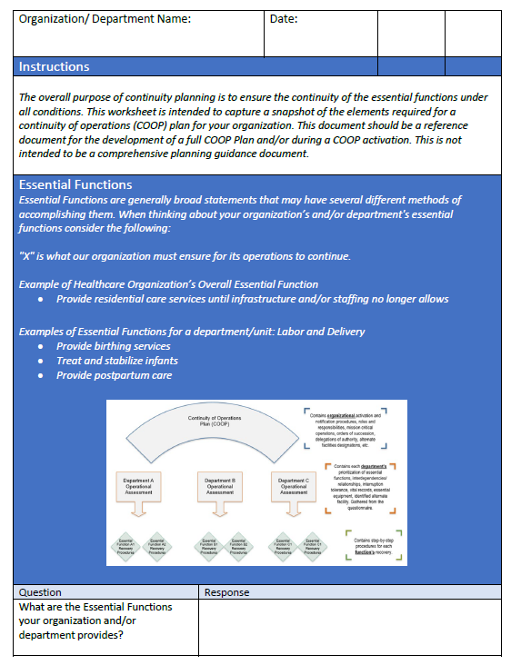
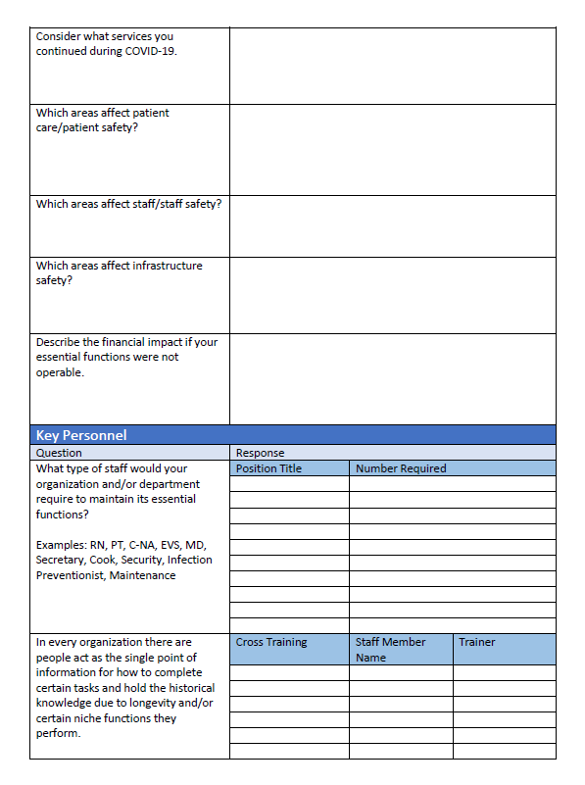

Slide 18
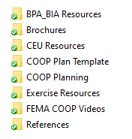
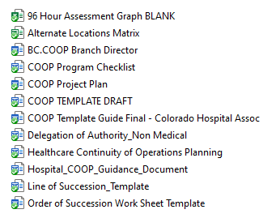
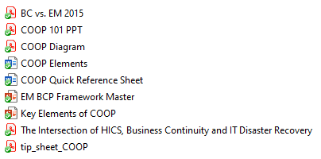
BUSINESS RECOVERY RESOURCES
Federal COOP
Basic COOP
Templates
Healthcare COOP
Notes:
LS – Brief Explanation of how to use this information – why is it being provided – differences of the materials

Slide 19
QUESTIONS?
Notes:
LS End

Slide 20
PRACTICAL APPLICATION
Notes:
WM

Slide 21
ACTION STEPS
To help your organization get started with this Business Recovery Toolkit, we recommend the following SEVEN action steps:
1. Send the Gap Analysis Worksheet to your emergency management committee, safety committee, QAPI team and/or the group which provide oversight for your organization’s emergency preparedness planning.
Tip: Prep your team prior to sending the worksheet and provide an overview of the ask and the why.

Slide 22
ACTION STEPS
2. Complete the Gap Analysis Worksheet, individually or as a group.
Tip: Don’t worry about perfection, just capture your first impressions.
3. Review the Gap Analysis Worksheet results as a team and then prioritize your organizations identified gaps (prioritization methods are provided at the end of the worksheet) to determine what need to be addressed immediately.
Tip: Representatives from all levels of the organization. Include people who are new to the organization.
Tip: Again, perfection is not necessary. You can re-prioritize
later or as you review over time.

Slide 23
ACTION STEPS
4. Incorporate your worksheet and findings into your COVID-19 AAR/IP.
Tip: Concepts and brief points. Don’t try to create a detailed, perfectly worded summary.
5. Send the Continuity of Operations (COOP) Planning Checklist to your emergency management committee, safety committee, QAPI team and/or the group which provide oversight for your organization’s emergency preparedness planning.
Tip: Provide specific, small steps you’re asking them to take.

Slide 24
ACTION STEPS
6. Complete the Continuity of Operations (COOP) Planning Checklist, individually or as a group.
Tip: Focus on gathering information and not on perfecting the document.
Tip: Capture details that explain “why” you provided each answer
7. Review the Continuity of Operations (COOP) Planning Checklist as a team and develop a timeline to create a COOP or update your current plan.
Tip: Ensure major concepts and concerns are addressed. Don’t get distracted with small details initially.

Slide 25
QUESTIONS?
Notes:
WM End

Slide 26
CONTACT INFORMATION
Will Moorhead, JD
President
WillM@AllClearEMG.com
Lauren Smith
Planning Specialist
LaurenS@AllClearEMG.com
www.AllClearEMG.com
336-802-1800
Notes:
LS Wrap

