Slide 1
Hazard Vulnerability & Risk Analysis
Shawn E Stoen
Regional Healthcare Preparedness Coordinator

Slide 2
OBJECTIVES:
Define what a Hazard Vulnerability Analysis (HVA) is and what it is used for in a health care facility.
Identify the different forms available to complete a HVA
Define Hazards and understand how those hazards can impact a facility

Slide 3
Who? What? Where? When? Why? And How?
Notes:
We will use the five W’s to understand the Hazard Vulnerability Analysis process

Slide 4
Who? Who needs to be involved in the Hazard Vulnerability Analysis?
Representatives from all departments
Managerial/administrative support

Slide 5
What? What is Hazard Vulnerability Analysis?
A tool used to identify the potential risks for a facility
A prioritization process that will result in a risk assessment for “all hazards”
It is NOT a rubber stamp or just a box to be checked – it is a working document
Notes:
Assigns a numerical value to hazards for planning, assessing and prioritizing the threats and allows the group to make informed decisions versus just creating a checklist
Is not all-inclusive however it provides a visual snapshot of issues – it is important that this document not be put on the shelf once completed – it needs to be reviewed and updated
It is a tool that can be used to demonstrate to management the risks and the level that the facility is prepared
Identifies gaps in planning and provides an area to focus on - provides the Long Term Care Steering Committee with the direction it needs to help plan for education and training initiatives over the coming year.

Slide 6
When is it conducted?
The HVA needs to be reviewed and updated annually
It is a living document
Notes:
As stated, the HVA is forever changing…..it must be updated annually however, it can be reviewed and updated sooner, such as after an event or an exercise.

Slide 7
Where?
Each facility is required to have an HVA.
If the facility is geographically separated then it needs to have its’ own HVA.
Notes:
Separate HVAs may be needed if there are multiple buildings on one campus, however have different capabilities. For example – the Health Plaza – has generator, but the surrounding buildings don’t. Their risks may look a little different.

Slide 8
Why? Why do we need a HVA?
Because Centers for Medicare and Medicaid Services says so!!!
It will identify areas most at risk and allow facilities to focus their preparedness planning on those risks

Slide 9
How? How do we do an HVA?
There are several models available
Most common and well known is the Kaiser Permanente model
Kansas Public Health model – is a variety of the Kaiser Permanente model
Delphi Model – much more robust and time consuming
CHAOS Model
Notes:
Two well known models are from
American Society of Healthcare Engineering (ASHE) (fee based)
Kaiser Foundation (free and available online)
Both models can be adjusted to fit the organization
The Kansas Model is an adaptation of the Kaiser Model and is also free

Slide 10
A Comparison of two HVA Models
Both the Kaiser Foundation Model and the Kansas Model include
Threats:
Human Events
Natural Events
Technological Events
Hazmat Events
Probability
Impact:
Human
Property
Business

Slide 11
Differences
Kansas Model includes warning time and duration as well as preplanning and equipment availability
Kaiser Model looks at preplanning, internal response timing and external response timing/availability

Slide 12
We will be using the Kansas Model today

Slide 13
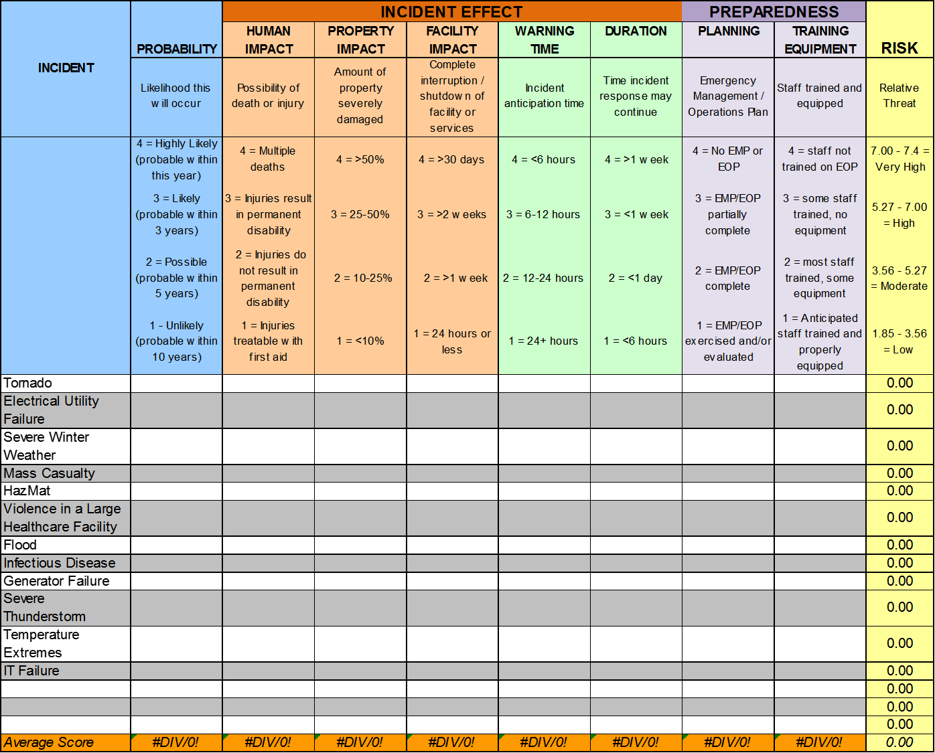
Notes:
This slide shows an example of the hand-out that you all have on your table. As you can see, the left hand side presents a list of potential hazards to your facility, and then presents the opportunity to self assess ultimately providing you with a realistic prioritization list for preparedness. Over the next few slides, we will discuss the different scoring areas and the considerations you should use in completing this tool.

Slide 14
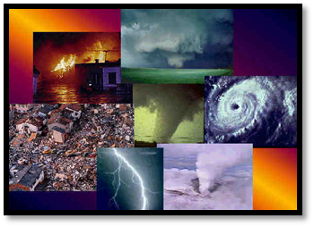
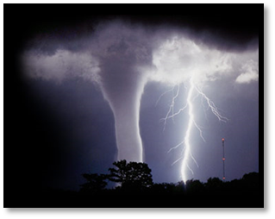
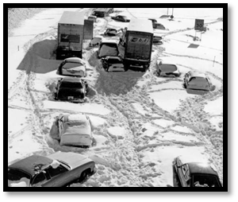
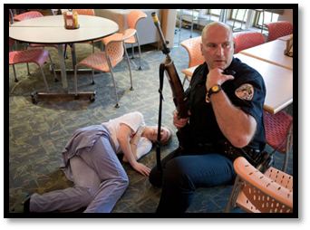
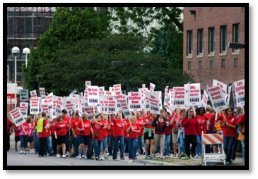
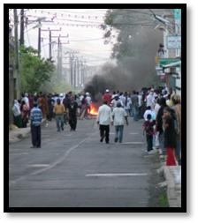
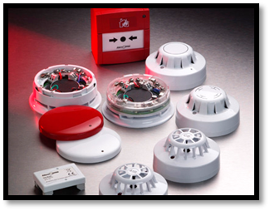
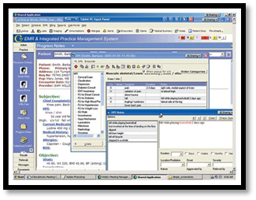
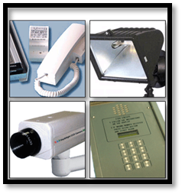
TYPES OF EMERGENCIES/INCIDENTS
NATURAL
HUMAN
TECHNOLOGICAL
Notes:
Emergency events are typically grouped into three categories.
Natural:
These are events out of our control that are a result of nature. Be it a thunderstorm, tornado, flash flood or … snow storm, these events affect our facilities in a variety of ways and because of their regularity need to be addressed and prepared for appropriately.
Human:
Events of human interaction include active shooters in your facility, civil disruption and work stoppages. These events can dramatically affect your ability to receive and provide services for your clientele. Because of the human element these events can be particularly frightening for the residents of your facilities posing a very unique type of threat to the health and safety of your residents and the facility as a whole.
Technological:
With advances in technology and our increased reliance on its operability, we have developed a susceptibility to a scenario where our reliance poses a threat to the facility in down times. Imagine a total loss of communications, power, fire detection for a period of a couple hours, days or weeks. The affect this would have on a facility is tremendous and is often the most over looked.

Slide 15
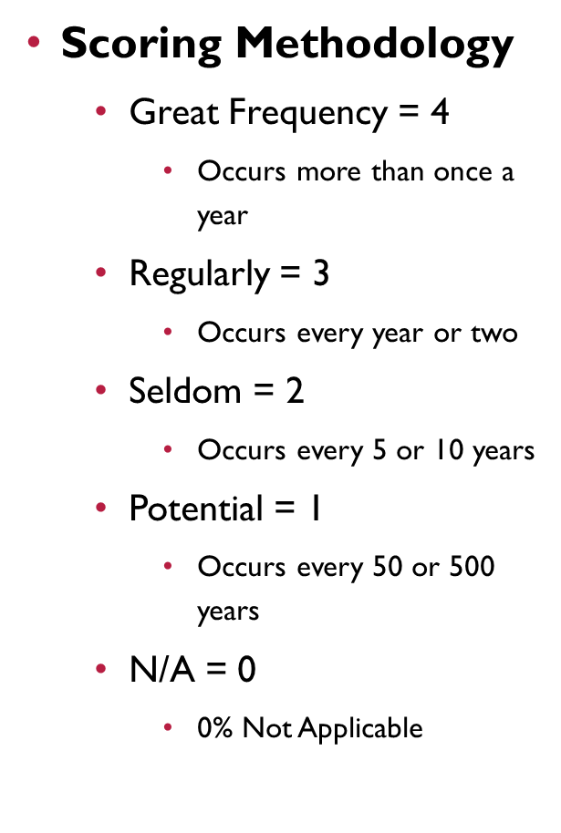
PROBABILITY
Notes:
Assessing probability often times open up the room to a lot of discussion. It is important that you consider…What do you KNOW? What does HISTORY show? What do THEY say? What do you THINK? And how do your PEERS assess the risk?
Using these questions as a base guide, consider a high probability something that you are 95-100% sure will happen this year. As Minnesotan’s we are well prepared or will not be surprised if we get snowfall during the winter months. Snow would be considered a “High Probability of Risk”. Snow would be considered a “4”.
Now the opposite would be low probability. The chances of us having a hurricane in Minnesota based on the known risk and historical data would be a 0 or 1.

Slide 16
INCIDENT EFFECT
The Human Impact column rates the incident’s possibility of injury or death to staff members.
The Property Impact column rates the incident’s possibility of severely damaging the facility. Severe damage can be considered that damage that limits or eliminates a portion of the facility for operation, impacting the facility’s ability to provide care.
The Facility Impact column rates the incident’s impact on interruption or termination of a facility’s services. Interruption of services in a facility may drastically impair the facility’s ability to provide care to patients and the community and may include the loss of equipment or personnel.
Notes:
When doing your facility HVA – it is important that you only consider your facility – not the neighborhood or the community. That would be a city or county HVA.
Property impact – structural damage
Facility impact – loss of water, electricity, internet

Slide 17
The Warning Time column rates the anticipation time for the identified incident. This criteria provides an opportunity to score how long staff and the community have to implement plans and procedures for the incident.
The Duration column rates the anticipated time that the incident may occur impacting the facility or community.
Notes:
Warning time – a hurricane warning can be days ahead of an incident – this warning allows for people to evacuate, stockpile supplies etc. A fire alarm provides little warning – action needs to occur immediately.
Duration – a tornado – comes and goes….. A snow storm may last for days

Slide 19
PREPAREDNESS
The Planning column rates the prior incident planning process that a facility has done in preparation for the incident.
The Training and Equipment column rates the completeness of staff training and availability of necessary equipment for staff to implement the plan.
Notes:
Planning is based on how advanced the planning process is. Have the plans been written, evaluated/tested, approved by management?
Training and equipment – so the plans have been written – does the staff know about the plan, where it is, how to implement the plan? Have they practiced the processes in the plans. Do they know where the emergency equipment is? Do they know how to use it?
An example – fire plans may indicate the usage of a fire extinguisher…..has staff been trained on how to use the fire extinguisher or is it just written in the plan (PASS – pull, aim, squeeze, sweep).

Slide 20
Take a few minutes at your table and discuss how you would rate your facility for a Tornado.
QUESTIONS?????
Notes:
So, now that you know the tool, lets put what you have learned into action……
Please feel free to ask any questions – I will walk around the room.

